Slide 1
MALABAR VOYAGES
Handcrafted Journeys, From God's Own Country to the World
A travel web application walkthrough, presented by Sayyid Midlaj
HTML5 · CSS3 · BOOTSTRAP 5 · JAVASCRIPT

Slide 2
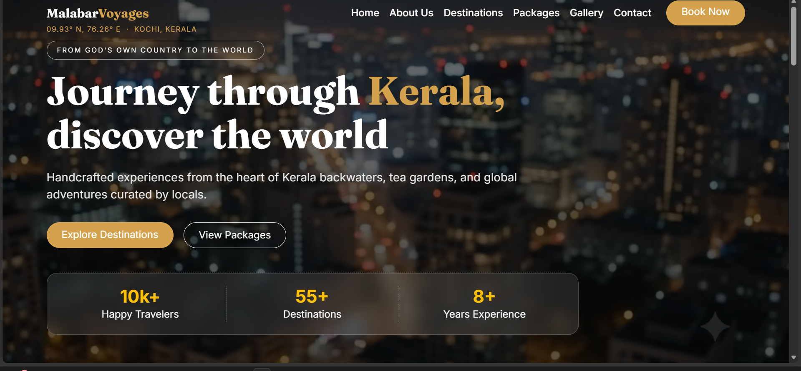
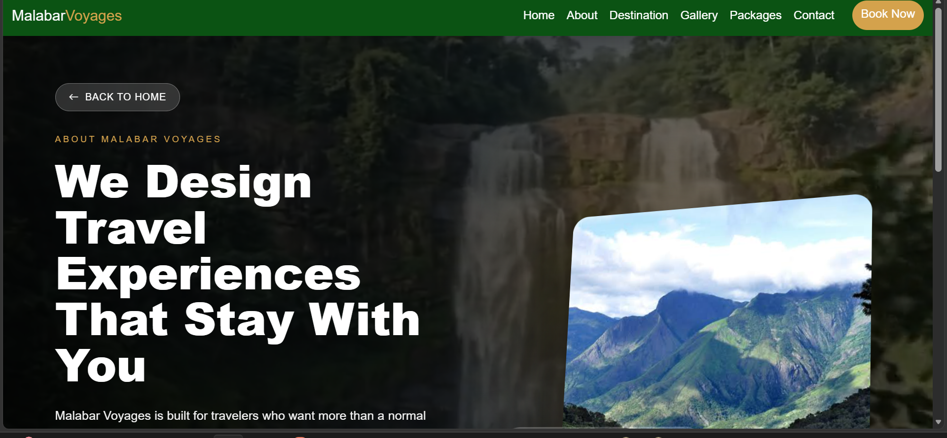
WHAT IS MALABAR VOYAGES
A Complete Travel Planning Platform
PURPOSE
Makes trip planning, destination browsing, and booking logistics simple and transparent for every traveler.
CORE GOAL
Connects travelers with handcrafted local experiences and hassle-free tour planning, from Kerala to the world.
WHO IT'S FOR
Tourists, families, honeymoon couples, and travel enthusiasts seeking domestic and international getaways.

Slide 3
KEY PLATFORM FEATURES
From Inspiration to Booking
01
02
03
04
Kerala Packages
India Packages
World Packages
About & Contact
Curated local tours covering Munnar, Alleppey, Wayanad, and Fort Kochi.
Iconic national journeys including the Taj Mahal, Jaipur, Kashmir, and Goa.
Handpicked international tours to Bali, Santorini, Dubai, Switzerland, and the Maldives.
Brand story and interactive lead forms connected to Formspree and WhatsApp.
Every feature is designed to guide travelers from browsing to booking with confidence.

Slide 4
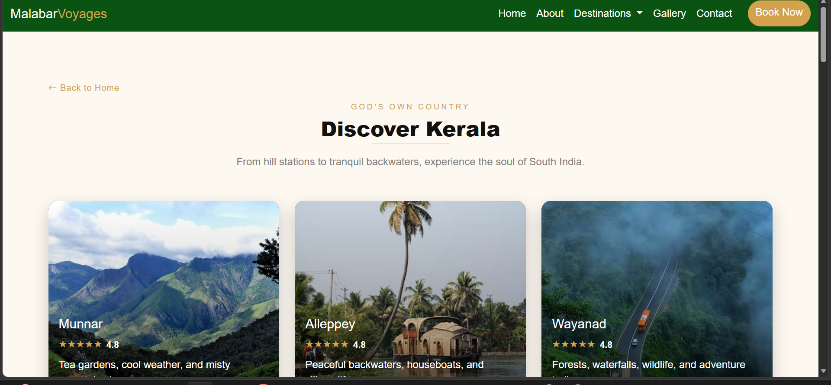
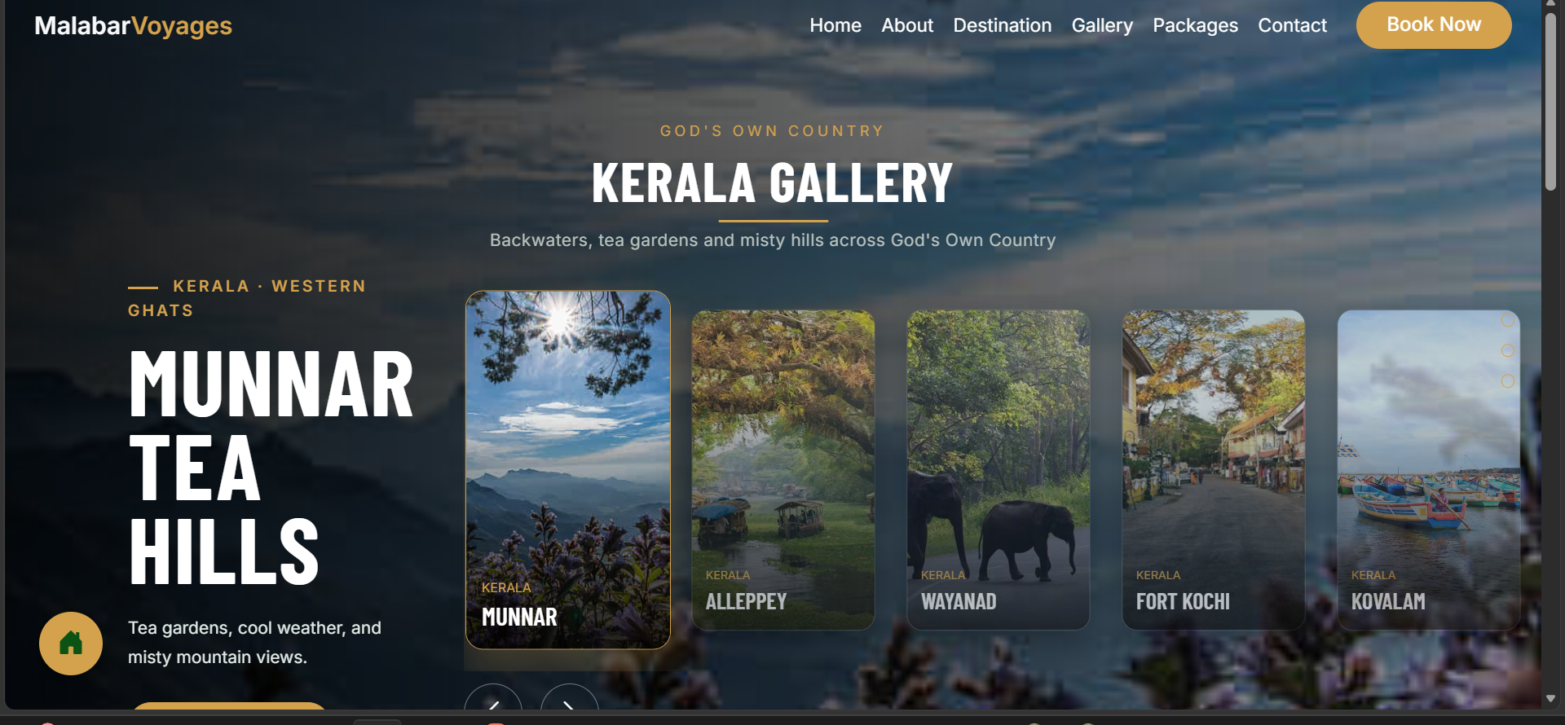
SITE WALKTHROUGH
Destinations & Gallery
Destinations — Kerala, India & World
Gallery — Interactive Regional Slider
Bootstrap-powered responsive cards, hover reveals, and a region-based slider drive discovery across Kerala, India, and world destinations.

Slide 5
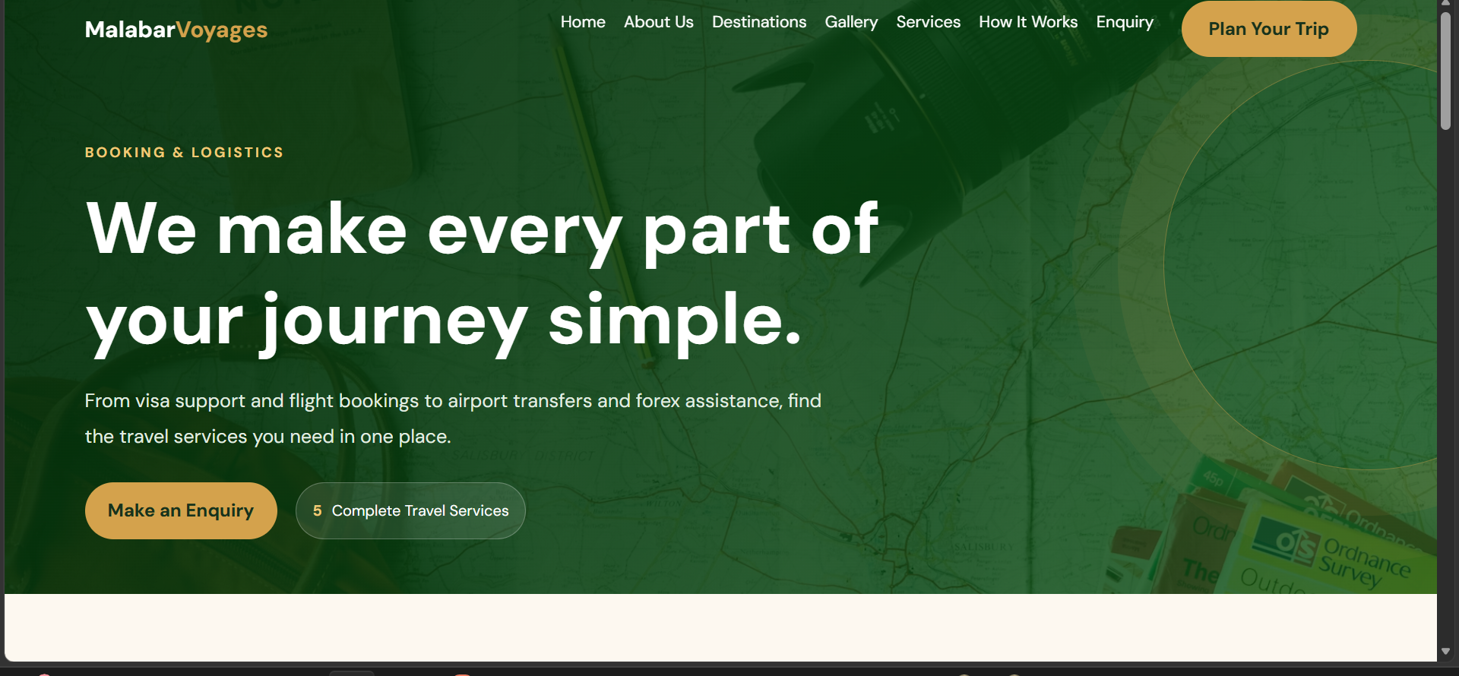
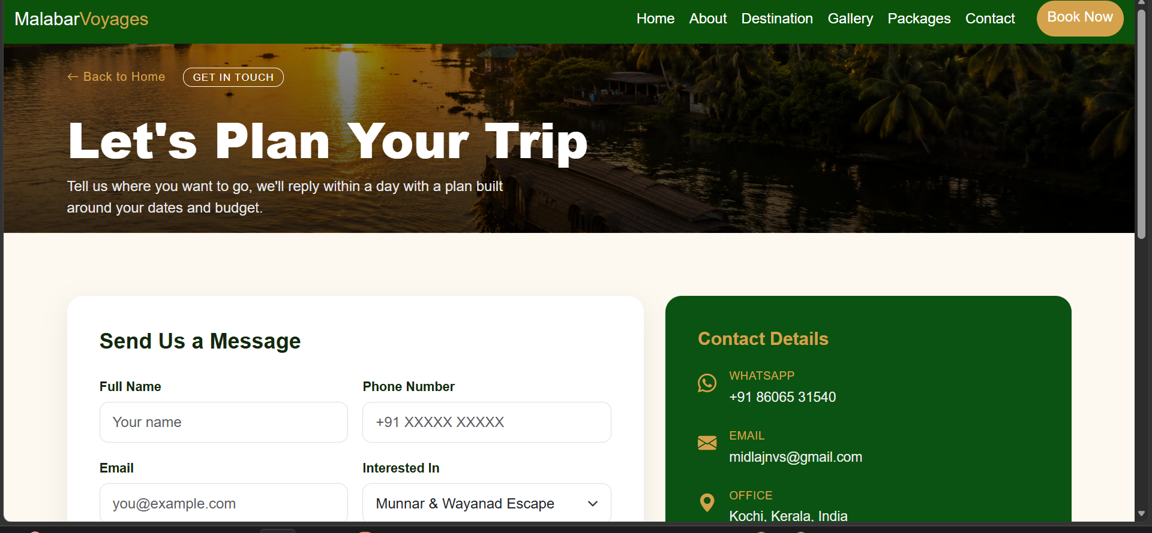
BOOKING & LOGISTICS
Every Part of the Journey, Simplified
Visa Assistance & Documentation
Travel Insurance
Flight Booking
Airport Pickup & Drop
Forex / Currency Exchange
Enquiry form connects directly to Formspree, with an instant WhatsApp chat option for real-time booking support.

Slide 6
TECHNOLOGY STACK
Built With Core Web Technologies
HTML5
CSS3
Bootstrap 5.3
JavaScript
Semantic markup structure across every dedicated page.
Custom styling, keyframe animations, and view-transition effects.
Responsive grid layout and interactive offcanvas navigation.
Client-side interactivity across forms, sliders, and menus.
Core focus page: traveling.html — showcasing scroll-driven navigation and pure-CSS :has() card selectors, no external JS frameworks required.

Slide 7
DESIGN & USER EXPERIENCE
Effortless by Design
BRAND PALETTE
Easy to Use
Deep Forest #0B5313
Clean, intuitive interface — find information within seconds.
Responsive Design
Warm Gold #D4A24C
Fully optimized across mobile, tablet, and desktop.
Cream #FDF8F0
Attractive Interface
Deep Forest Green and Warm Gold brand theme throughout.
Easy Package Selection
Quick Navigation
Interactive selection logic highlights the chosen plan while dimming others.
Instant transitions and quick-jump links between sections.

Slide 8
THANK YOU
Malabar Voyages is more than a project — it's a vision for how travel should feel: personal, seamless, and unforgettable.
QUESTIONS?
Happy to walk through any feature in detail.
Sayyid Midlaj · Palakkad, Kerala
Designed with ♥ in Kerala

